Slide 1
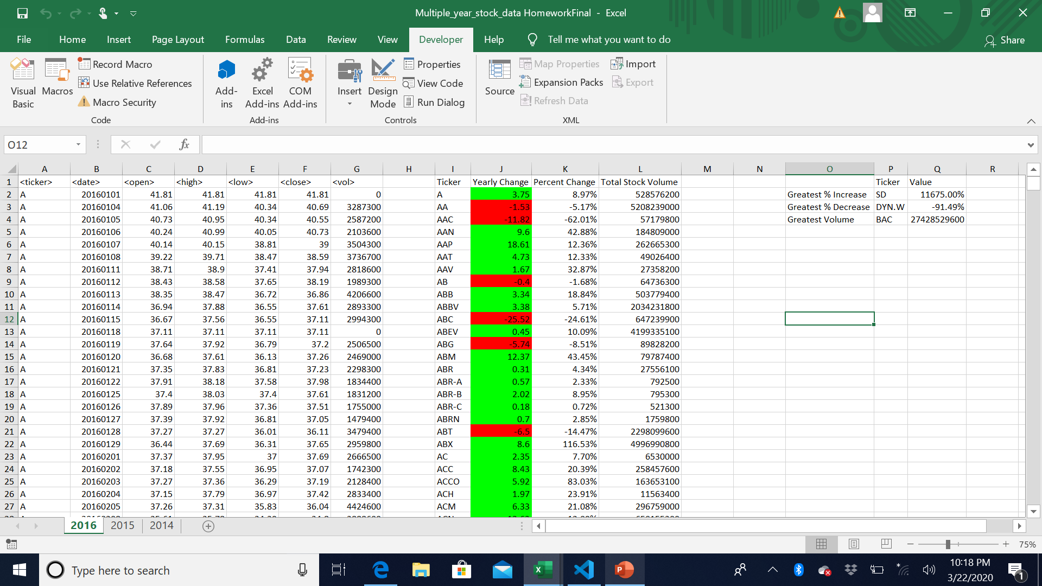
Note: this is for tab 2016; I was not able to get the script to run on tabs 2015 or 2014… it did read the names of the tabs via a msgbox, but did not execute the script to produce any results

